Slide 1
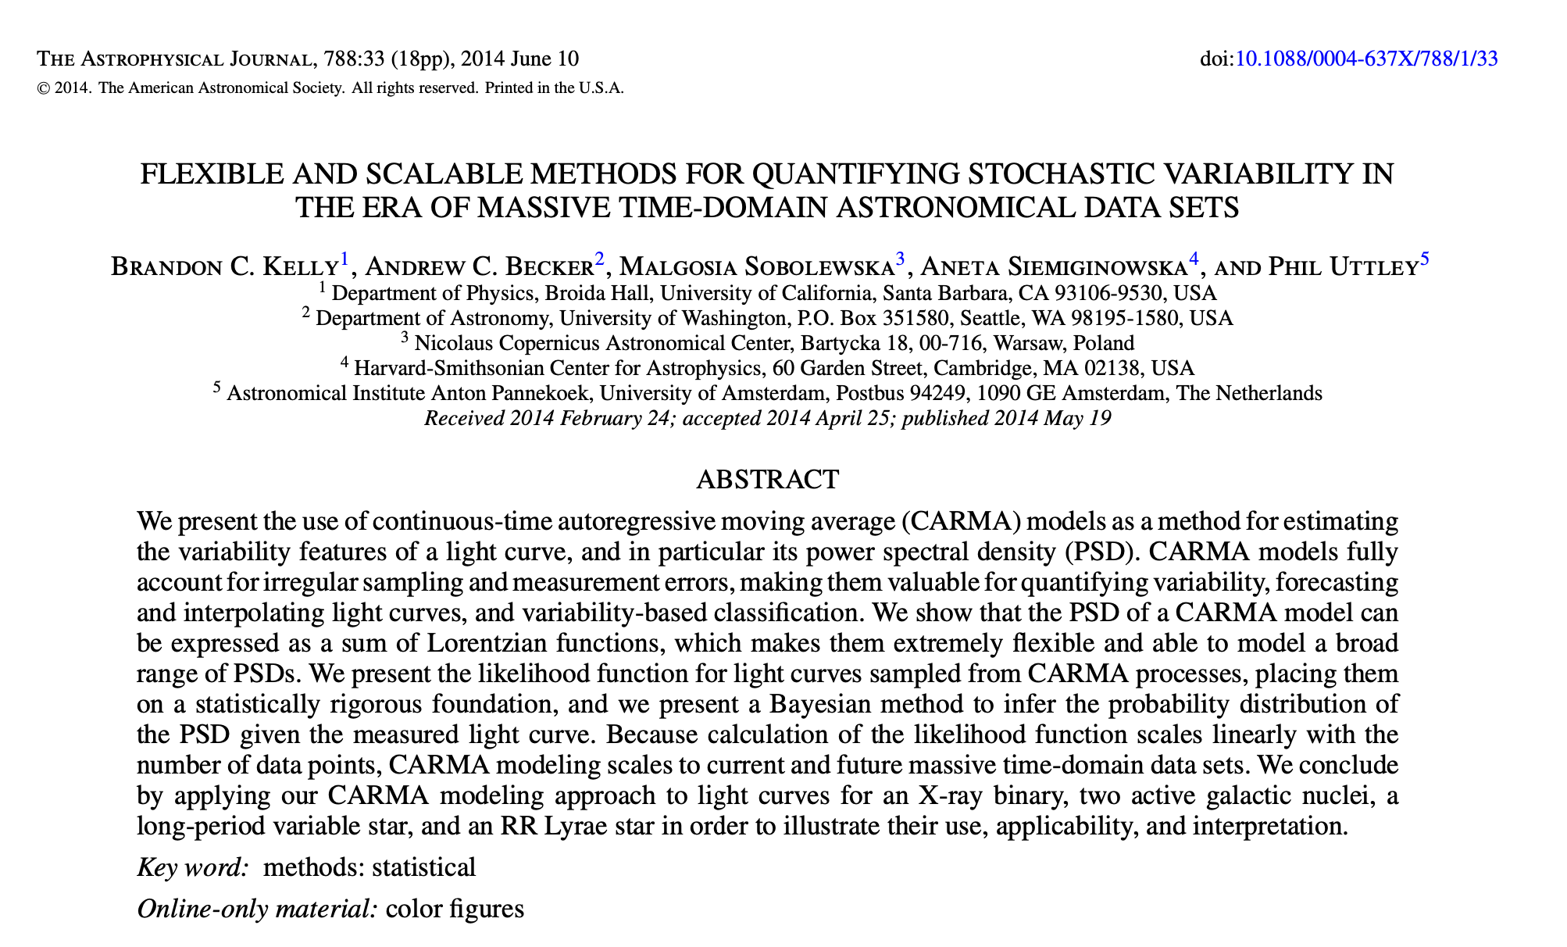
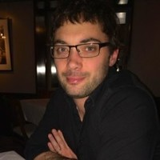
HOMEWORK 5 - CARMA models
Brandon C. Kelly

